Slide 1
What’s new in Kofax RPA 11.3
April 2022
David Wright, Partner Development Manager

Slide 2


Two kinds of Robots
Robot
True Workflow – flows forward.
Desktop Robot
Desktop Automation Robot
Device Automation Robot
Robot Language 2
Basic Engine Robot
Not a workflow, it can go backwards.
Robot
Classic Robot
Old Robot
Robot Language 1

Slide 3






What’s new in Robots
Date & Time | File System | Email | Databases | Chromium | Desktop Screen Lock
Reading, Formatting, Converting, Time Zones, Quarters, Leap Years, Next Week, Last Year, “Montag”, … | Directory, File, Exist, Read, Write, Copy, Move, Delete, Size, … | IMAP/POP3, Copy, Delete, Move, Mark as Read, Body, Get Attachments | Store, Query | Duplicate Window, Name, Download Data, Custom Headers

Slide 4
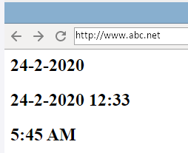
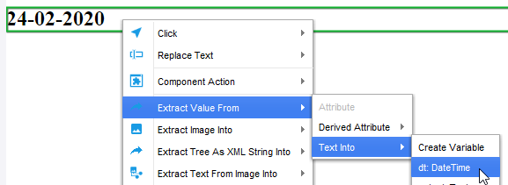
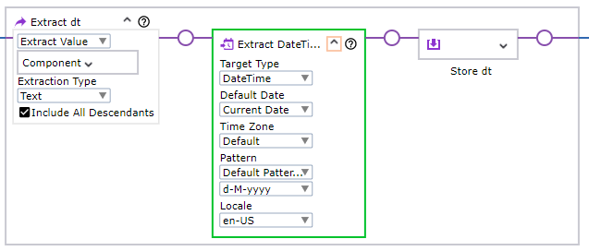
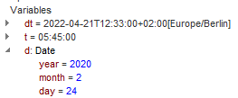
Extracting Dates, DateTimes and Times
Dates
The documentation explains all date pattern symbols

Slide 5
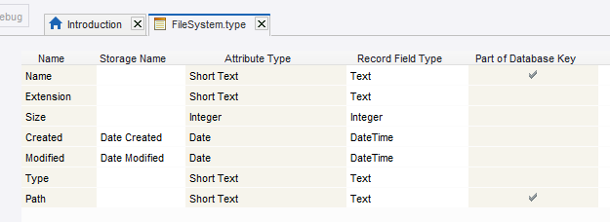
You can now use Date Attributes in types for Robots!
Basic Engine Robots have type Date.
Robots have three types: Date, Time and DateTime.

Slide 6
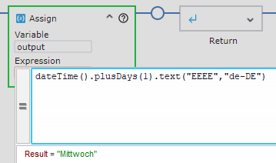
Date, Time & DateTime Expressions
 | Expression | output
Name of tomorrow in German | date.plusDays(1).text(“EEEE”, “de-DE”) | “Mittwoch”
My time offset and zone | dateTime().text("Z") dateTime().zoneId() | “+0200” “Europe/Berlin”
Day that is 2 weeks after “24. Feb 2022” | “24. Feb 2022”.date(“DD. MMM YYYY”, “en”).plusWeeks(2).day() | 8 (8th of March)
Noon on 24. Feb 2022 in Excel Date format | dateTime(date(2022,2,22),time(12,0,0)).toExcelDate() | 44614.5
5 AM tomorrow morning | dateTime().plusDays(1).withHour(5).withMinute(0).withSecond(0) dateTime().date().dateTime(time(5,0,0)) | 20220420 05:00:00

Slide 7
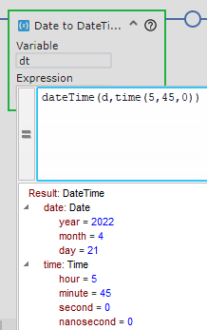
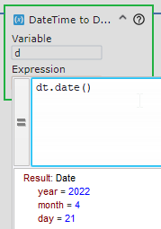
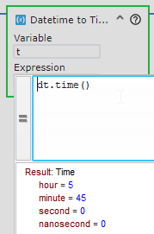
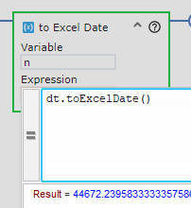
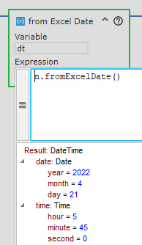
Converting between Date formats
Date + Time to DateTime | DateTime to Date | DateTime to Time | DateTime to Excel | Excel to DateTime

Slide 8
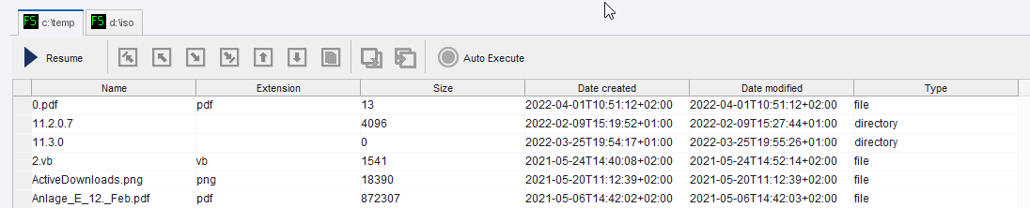
File System List, Create, Delete, Move, Close & Refresh Directory
Multiple directories are supported!

Slide 9

Files
Move
Rename
Copy
Delete
Get Path
Get Type (file or directory)

Slide 10
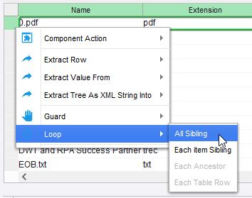
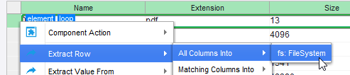
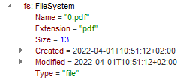
Loop through files

Slide 11
File System Tips
Use this Type to easily load File data.
Storage Name has 2 functions
Map to an SQL column in a database
Match column names during “Extract Row” in a robot.

Slide 12


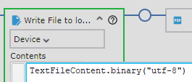
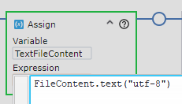
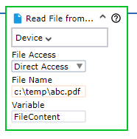
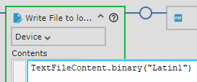
Read and Write Files
All Files (text, pdf, Excel, image, etc) must be read into a Binary variable
How to read a Text File
Encoding=ASCII, utf-8, Latin1, windows-31j (Japanese), etc
Search online for “java supported encoding”
How to write a Text File

Slide 13





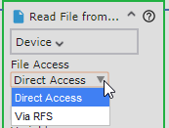

Robot File System – Secure, Safe, built to enable Compliance
Project Mode
All robots in the project can Read/Write this persistent File System.
Robot Mode
This file system is deleted when the robot exits.
Apache Tomcat®
Robot File System
Management Console
Desktop Automation
R:\
C:\
Robot

Slide 14
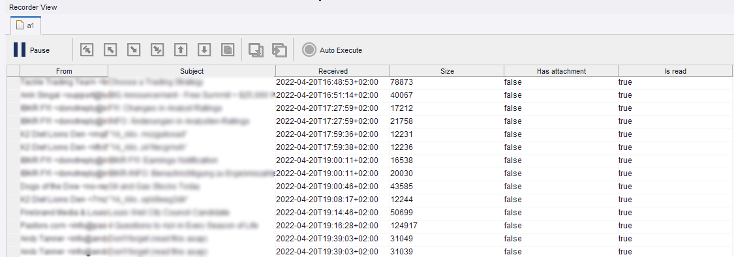
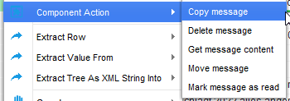
Read Email Step
Replaces Email Action in 11.2 (no more polling)
IMAP, POP3.
Actions: Copy, delete, move, mark as read, Get Content

Slide 15

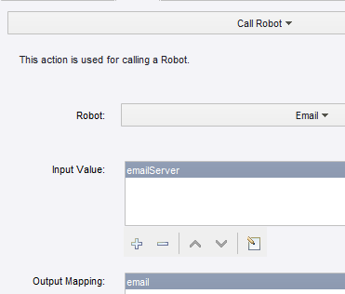
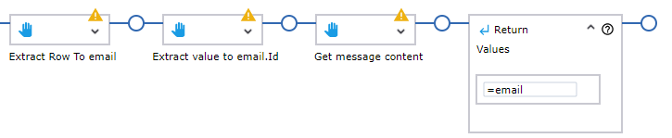
Return Email Content to a Basic Engine Robot
Tip: store email in database and delete! parallelism, speed and security
Load content into a Text variable
Return the email to the host Basic Engine Robot

Slide 16
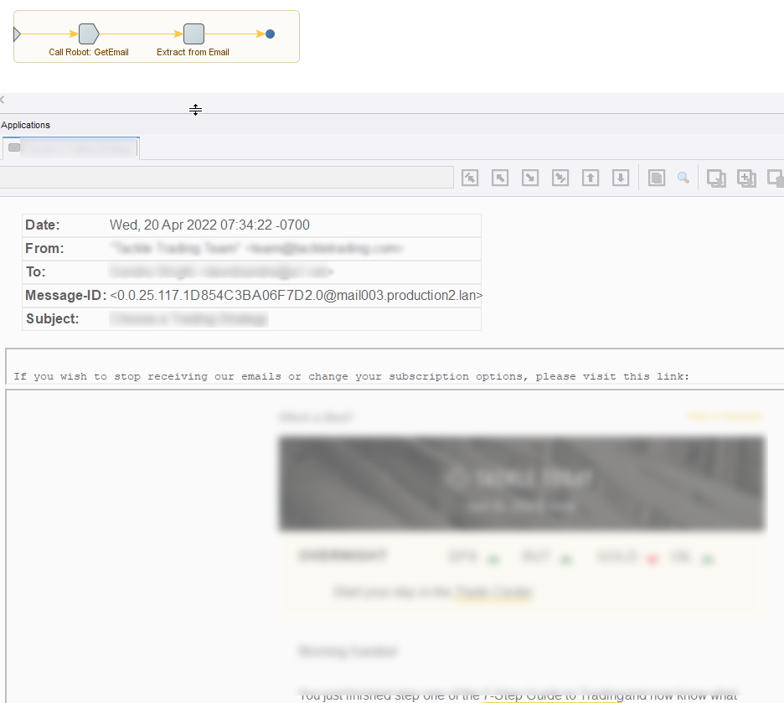
Open Email with “Extract From Email” Step
All Headers
Recipients
Body
Images
All Attachments

Slide 17
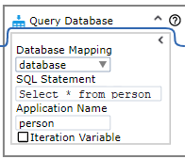
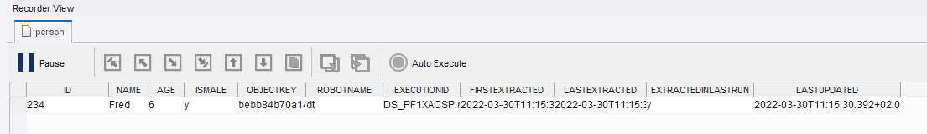
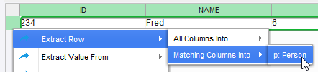

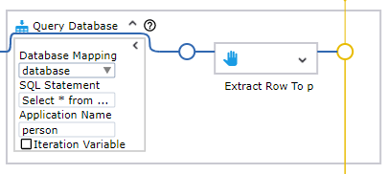
Databases in Robots
Query Database
Audit Data is now optional!

Slide 18
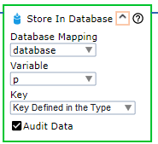

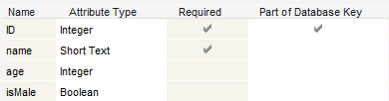

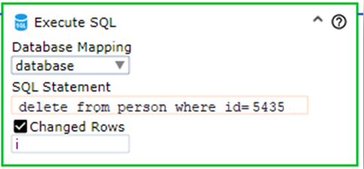
Database Steps
Store in Database
RPA works out if this is new item or a change to an existing item.
Execute SQL
Video on keys and Audit Data in Databases
https://bit.ly/3vKk7Hi

Slide 19
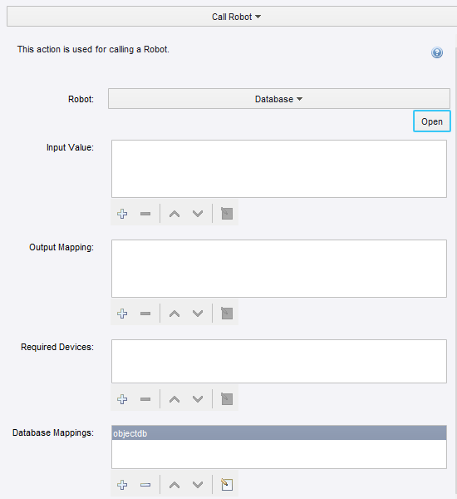
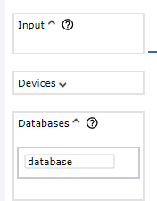
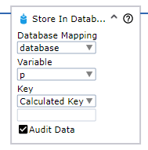

Database Mappings in Robots
Basic Engine Robot Database & Mapping | Robot Config | Database name in Robot | Use Database in Robot Step

Slide 20
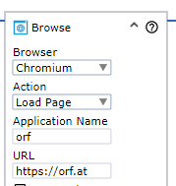
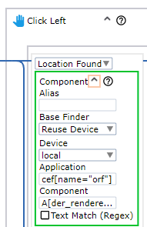
Chromium Browser
You MUST give
An Application Name
The Application Name will be automatically used in Finders
This will prevent problems when multiple browser windows are open

Slide 21
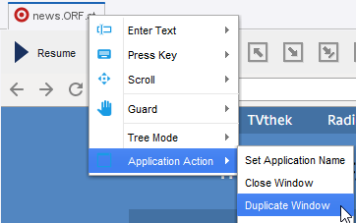
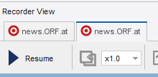
Chromium Browser
Duplicate window to keep login session, cookies etc the same.

Slide 22
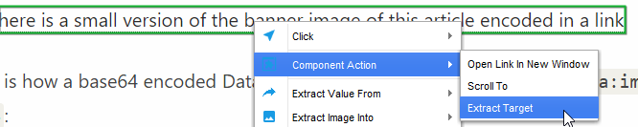

Chromium Browser – some advanced features
Some download links on some websites don’t give a file link, they give a Data URL, which dynamically creates the document you want.
Chromium now supports custom additional HTTP headers (Cookies, Authentication)

Slide 23
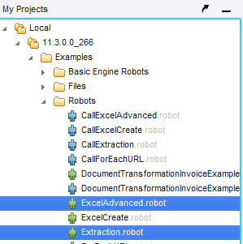
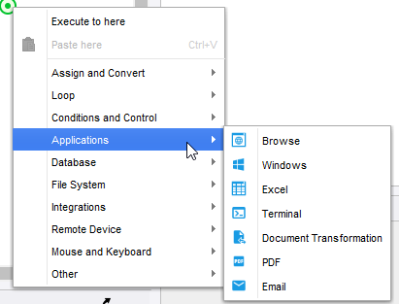
Design Studio
New example robots
Robot Errors in logs now create URLs to load robot at that location
Step Menu has icons and nice groupings of 45 step.

Slide 24
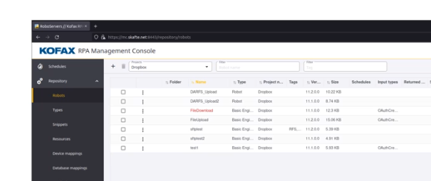
Management Console
Column filtering and sorting is improved
Shows missing resources are shown in red, and can be directly uploaded.

Slide 25
Kapplets
K
The output of one BE Robot can now feed another BE Robot
Backup & Restore of entire Kapplets environment (workspace, users, …)
Login now uses Management Console User Management (this allows SSO)
Token Based authorization between Kappets and MC to provide additional security

Slide 26
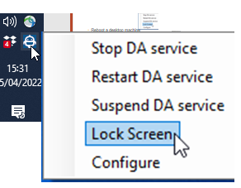
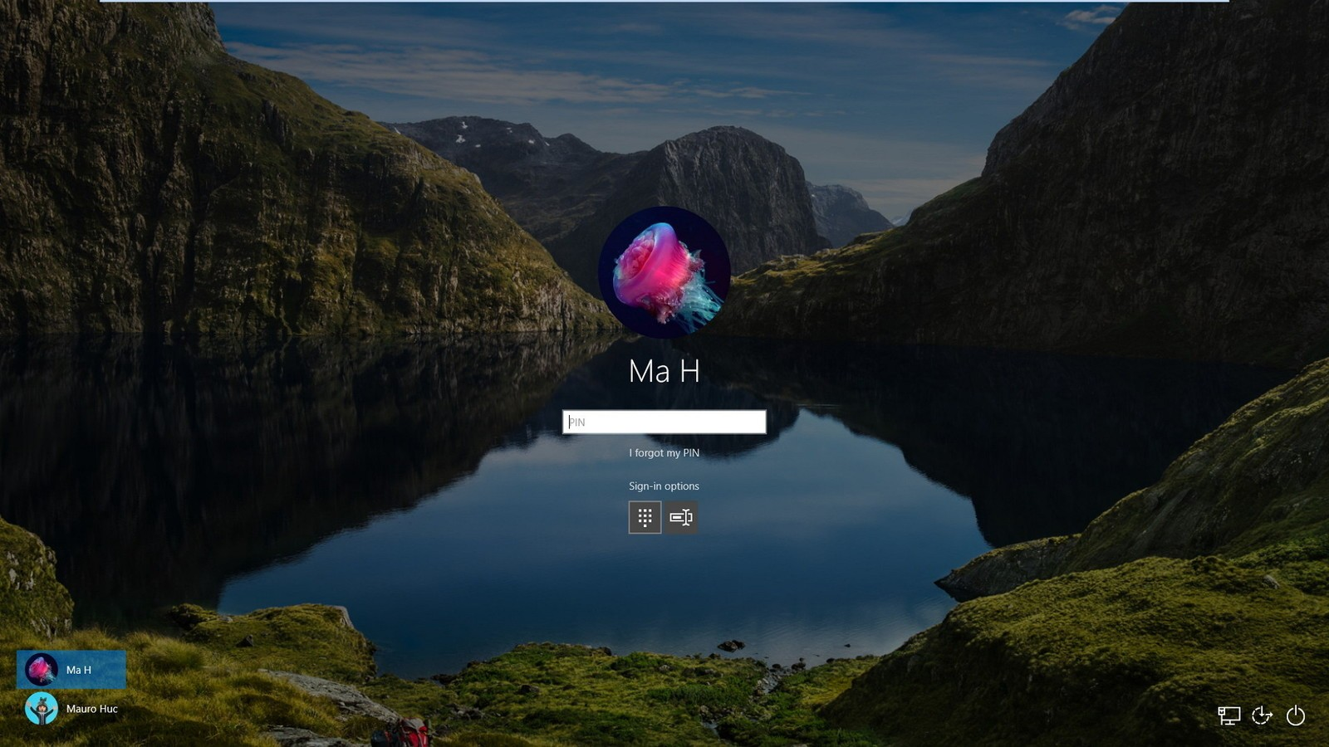
Desktop Lock Screen
Reboot a desktop machine
Log in to machine
Start Desktop Automation Service
Lock the screen

Slide 27
Thank you!
Q&A
This presentation and robots are at https://github.com/KofaxRPA

